Slide 2
Detecting Fraudulent Transactions in the Ethereum Network
By
Charity Mwanza

Slide 3

Introduction
Ethereum is a blockchain platform upon which smart contracts are built and deployed.
Ether digital currency is a utility currency that is used by users to pay for use of Ethereum resources.
Ethereum has been subject to numerous attacks such as
Smart-ponzi schemes
Phishing
Other fraudulent activities

Slide 4
Objectives
The problem
Increase in number of fraudulent transactions in the Ethereum platform
The goal
Predict if a user is fraudulent
Value
Take measures to protect the users from loss associated with fraudulent transactions

Slide 5
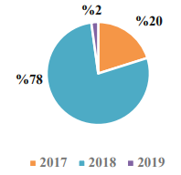
Dataset
The data was acquired from
https://github.com/salam-ammari/Labeled-Transactions-based-Dataset-of-Ethereum-Network
71251 Ethereum transactions
2558 fraudulent transactions
Transactions from 2017 to 2019 with 15 columns

Slide 6
Dataset Columns
Hash
Nonce
Transaction_index
From_address
To_address
Value
Gas
Gas_price
Input
Receipt_cumulative_gas_used
From_scam
To_scam
From_category
To_category
Date

Slide 7
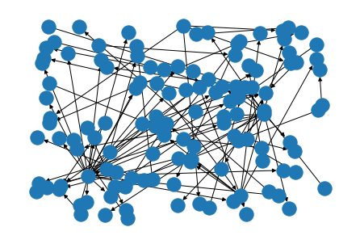
Node Visualization

Slide 8
Methodology
Python libraries used
Keras
Stellargraphs
Numpy
Pandas
Sklearn
Data Pre-Processing
Separate node features, edge features, response
Predict data
Evaluate results
Create stellargraph
Hyperparameter tuning

Slide 9

Data Preprocessing
Check for null values
Split data into nodes and edges
Identify the response variable
Drop unwanted columns (from_category, to_category)
Feature creation
Bin value column into categories
Separate date column into the year, month

Slide 10
Graph Neural Networks
Applied stellargraphs library in this research.
Used undirected graphs to connect between nodes.
Node features
Number of transactions
Year of enrolment
Maximum value of transaction category

Slide 11
Graph Neural Networks
Edge features
Gas
Gas_price
Receipt_cumulative_gas_used
Receipt_gas_used
Block_number
Value_cat
Number of years in operations
Response
From_scam
To_scam

Slide 12
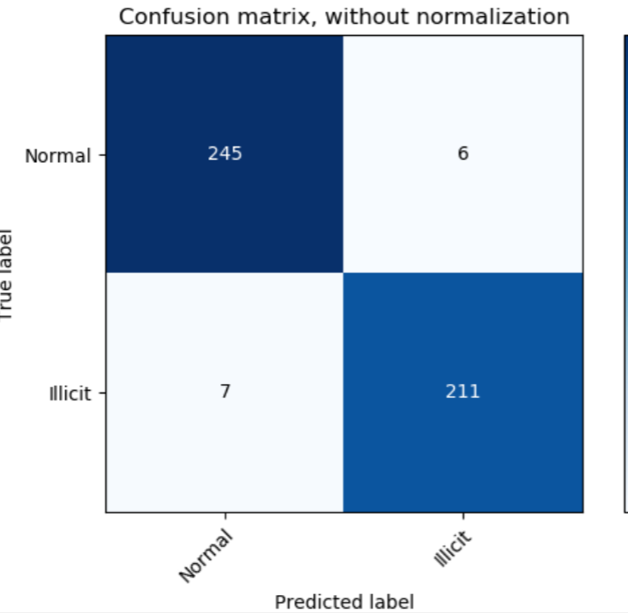
Results
Recall = tp/(tp+fn)
Recall is useful in predicting the real ones in past events that have already occurred
It is important in our data to predict fraudulent users as fraudulent
Maximum recall for our data
Training = 0.7692
Validataion = 0.8237

Slide 13
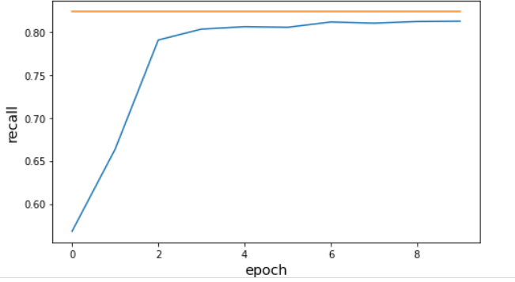
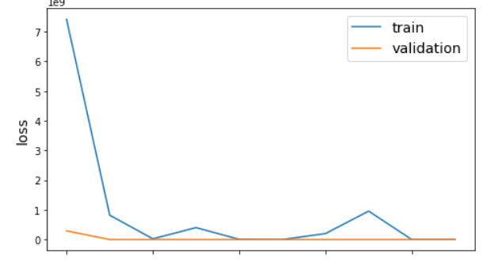

Results

Slide 14
Parameter Tuning Results
Parameter | Minimum loss | Maximum recall
Optimizers using GNC method
Adam optimizer | 123465 | 0.78
SGD Optimizer | 11234512 | 0.25
RMSprop | 95423 | 0.21
Optimizers using SGC method
Adam optimizer | 15263 | 0.35
SGD Optimizer | 2530 | 0.13
RMSprop | 8965 | 0
Optimizers using self loop method
Adam optimizer | 0.6612 | 0.8237
SGD Optimizer | 15.38 | 0.36
RMSprop | 126 | 0.17

Slide 15
Thank you!
cm0260@uah.edu

